Slide 1

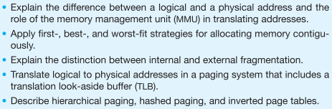
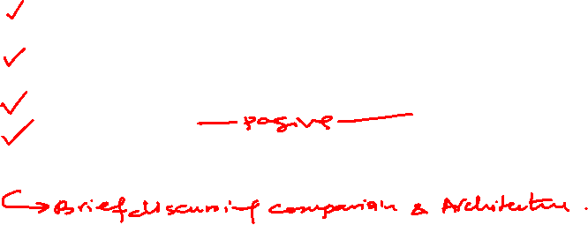
Topics
Address binding
Logical vs physical addresses
Protection of Addresses
Relocation of Addresses
Dynamic Reallocation
Static and Dynamic Linking
Memory Allocation for Processes
Fragmentation (Internal + External)
Solution for external Fragmentation (Algorithms)
Paging
Motivation, concept, page to frames translation, paging table, size of pages,
Allocation of frames at process creation
Programmer vs paging view of memory
TLB + related textbook calculations
Protection in paged environment
Shared pages
Structure of page table (brief)
Swapping
Student must read from the textbook.
Week # 14

Slide 2
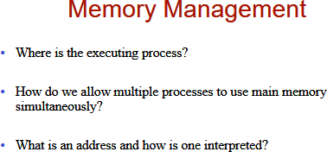

Slide 3
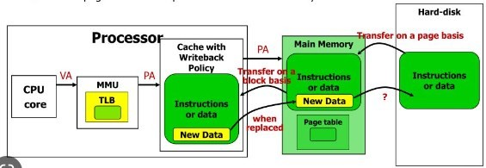

Memory Management (Big Picture)

Slide 4
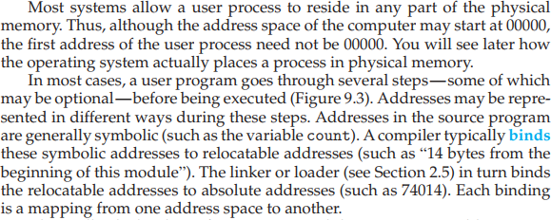
As studies in the COAL, all variables addresses are base + offset from data segment.

Slide 5
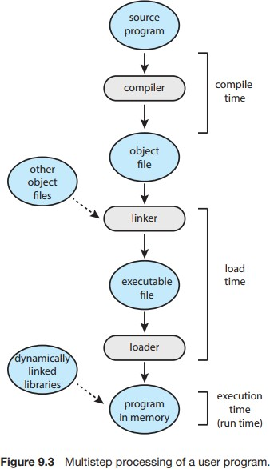
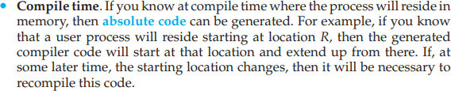
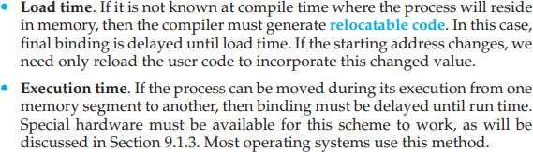


Slide 6
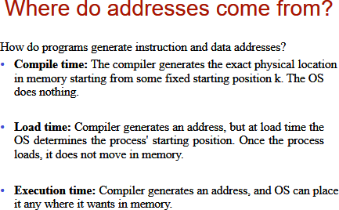

Slide 7
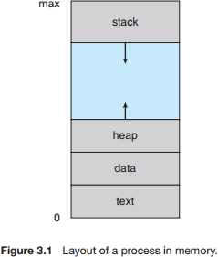
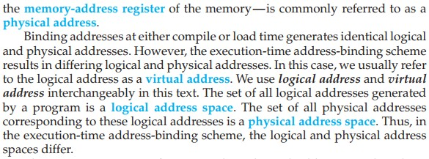
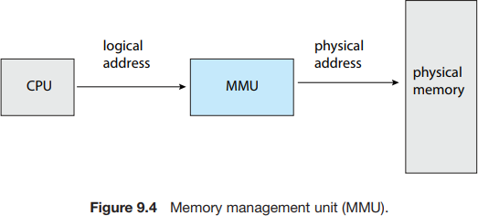
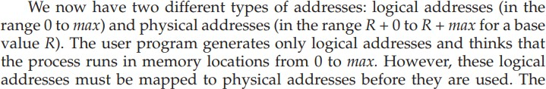
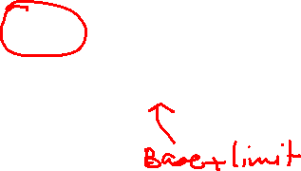

Slide 8
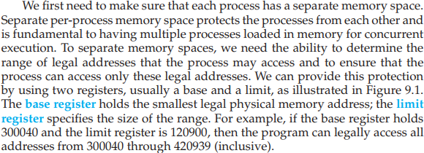
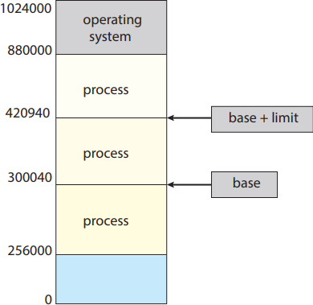
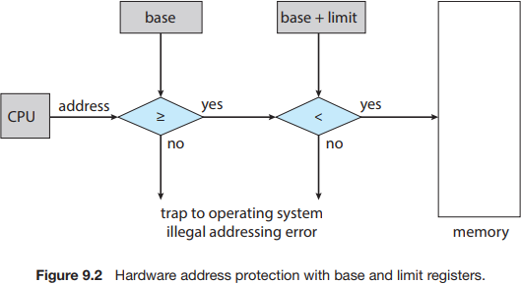
Protection of Process address space (1)
Also called Relocation Register

Slide 9
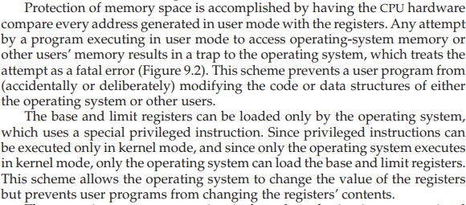


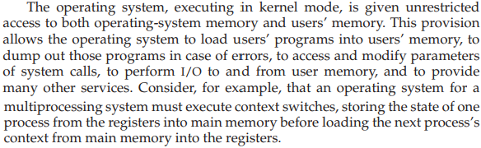


Protection of Process address space (2)
Kernel has unrestricted access.

Slide 10
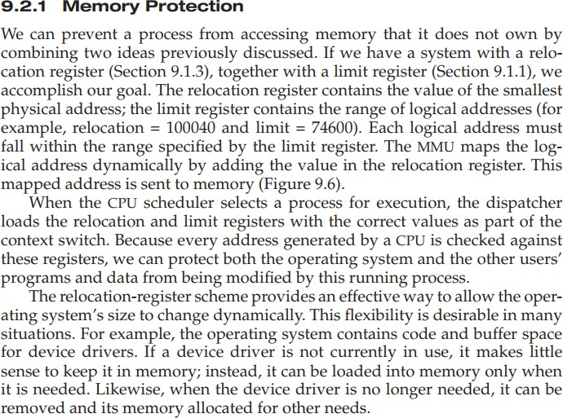
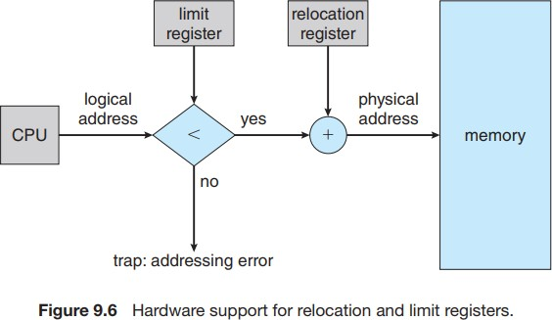
Protection of Process address space (3)

Slide 11
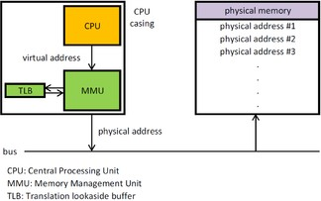
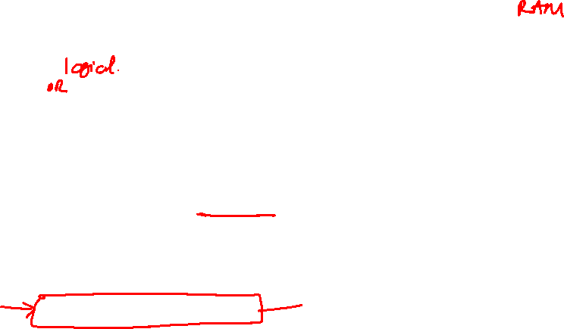
Memory Management Unit
Special cache used by MMU.
It is different from data cache and instructions cache.
A memory management unit (MMU), sometimes called paged memory management unit (PMMU), is a computer hardware unit having all memory references passed through itself, primarily performing the translation of virtual memory addresses to physical addresses.

Slide 12
User program always generates Logical/Virtual Addresses
The user program never accesses the real physical addresses.
The program can create a pointer to location 346, store it in memory, manipulate it, and compare it with other addresses—all as the number 346.
Only when it is used as a memory address (in an indirect load or store, perhaps) is it relocated relative to the base register. The MMU converts logical addresses into physical addresses.
This form of execution-time binding was discussed in Section
9.1.2. The final location of a referenced memory address is not determined until the reference is made.

Slide 13
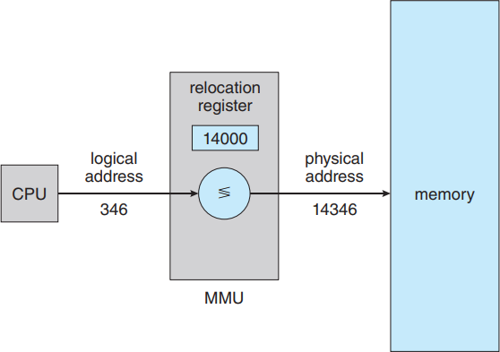
Relocation of Addresses
The base register is now called a relocation register.
The value in the relocation register is added to every address generated by a user process at the time the address is sent to memory (see Figure 9.5).
For example, if the base is at 14000, then an attempt by the user to address location 0 is dynamically relocated to location 14000; an access to location 346 is mapped to location 14346.

Slide 14
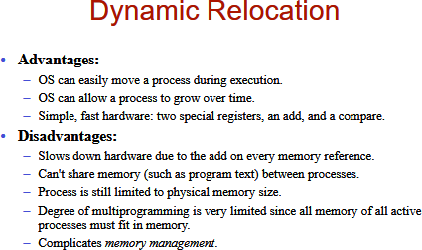
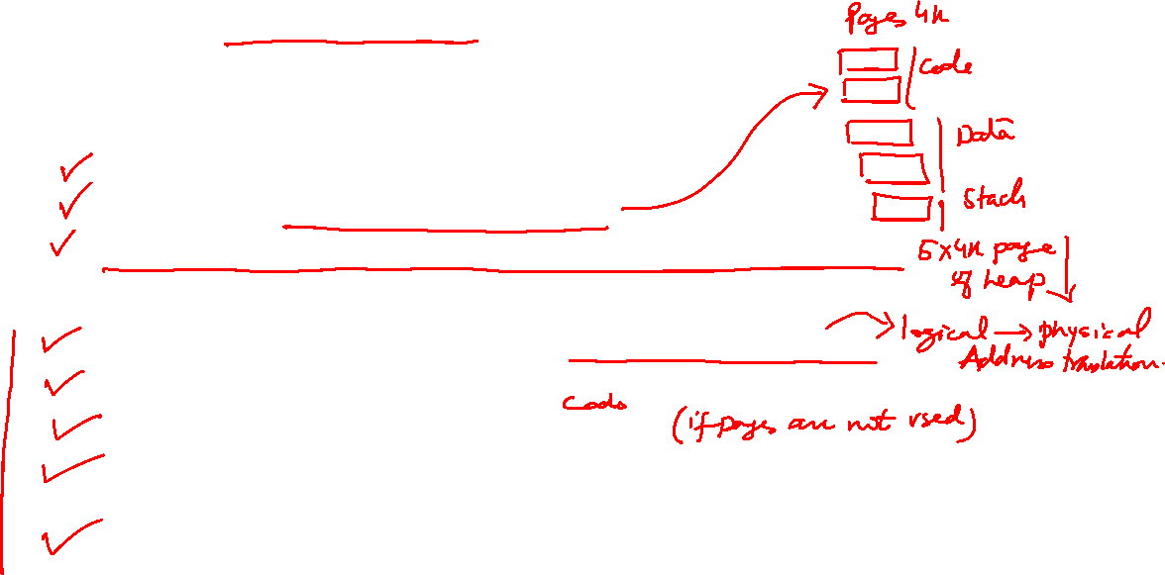

Slide 15
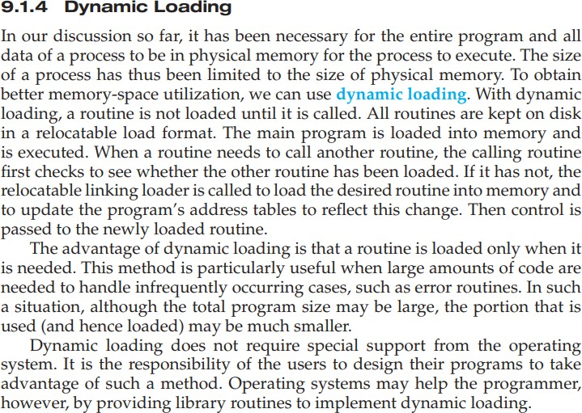
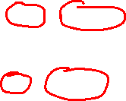
Self Reading – Part of Syllabus
Static Linking vs Dynamic Linking
Windows:
.lib vs .dll files
Linux:
.a vs .so files

Slide 16
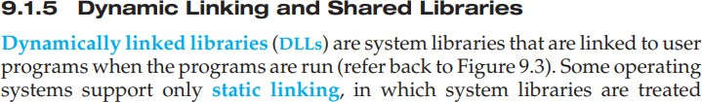
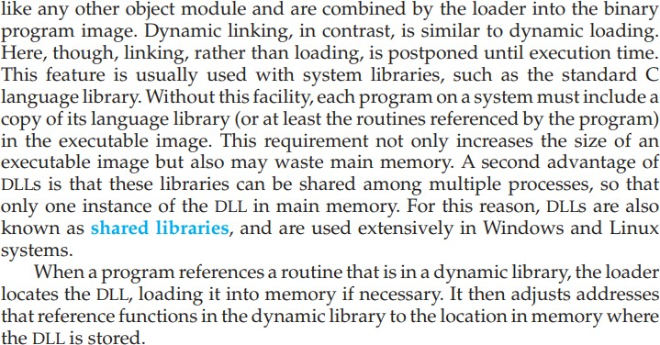

Slide 17
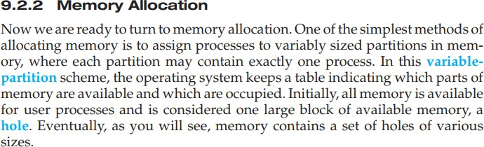
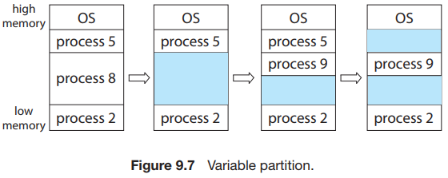
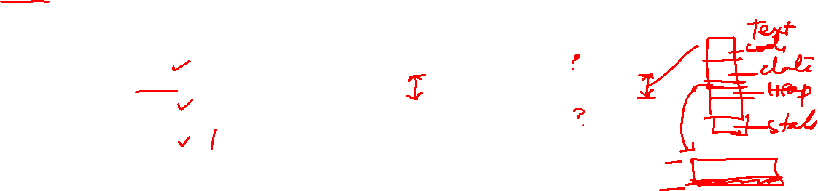

Slide 18
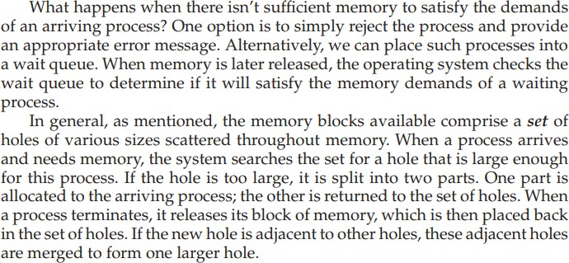

Slide 19
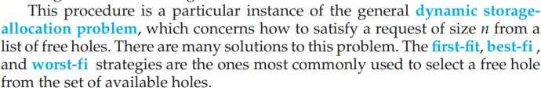
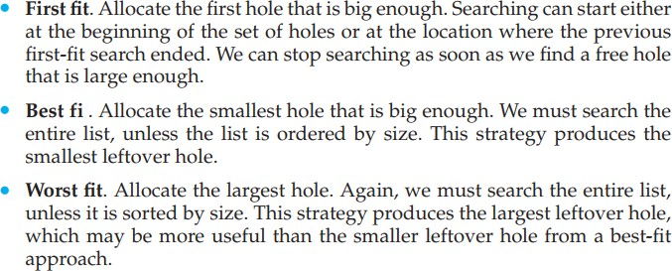
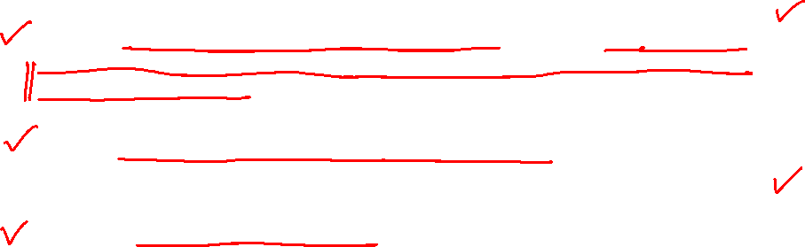
Simulations have shown that both first fit and best fit are better than worst fit in terms of decreasing time and storage utilization.
Neither first fit nor best fit is clearly better than the other in terms of storage utilization, but first fit is generally faster.

Slide 20
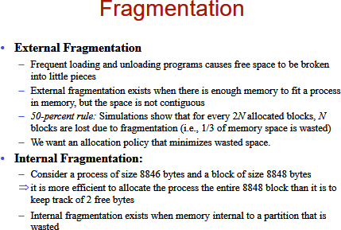


Slide 21
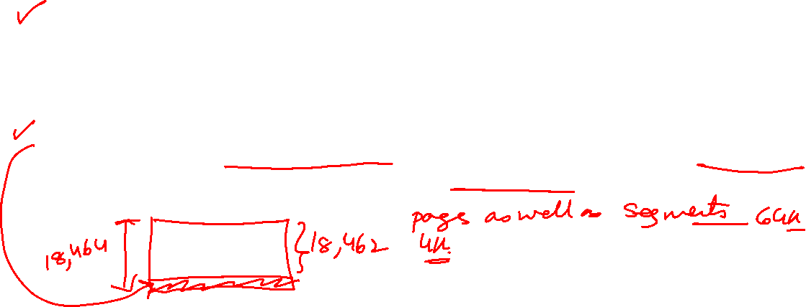
External fragmentation exists when there is enough total memory space to satisfy a request but the available spaces are not contiguous: storage is fragmented into a large number of small holes. Statistical analysis of first fit, for instance, reveals that, even with some optimization, given N allocated blocks, another 0.5 N blocks will be lost to fragmentation. That is, one-third of memory may be unusable! This property is known as the 50-percent rule.
Internal fragmentation is unused memory that is internal to a partition. Consider a multiple-partition allocation scheme with a hole of 18,464 bytes. Suppose that the next process requests 18,462 bytes. If we allocate exactly the requested block, we are left with a hole of 2 bytes.

Slide 22

Solution # 1 - Compaction
One solution to the problem of external fragmentation is compaction.
The goal is to shuffle the memory contents so as to place all free memory together in one large
block.
Compaction is not always possible.
If relocation is static and is done at assembly or load time, compaction cannot be done.
It is possible only if relocation is dynamic and is done at execution time.
If addresses are relocated dynamically, relocation requires only moving the program and
data and then changing the base register to reflect the new base address.
When compaction is possible, we must determine its cost.
The simplest compaction algorithm is to move all processes toward one end of memory; all holes move in the other direction, producing one large hole of available memory.
This scheme can be expensive.

Slide 23
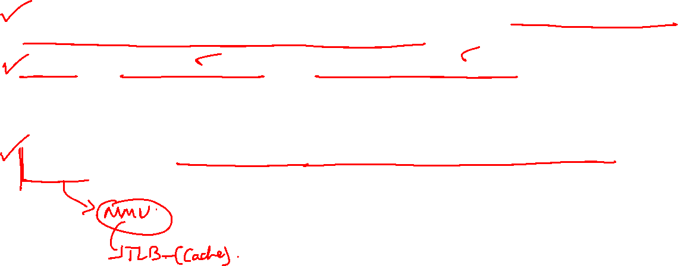
Solution # 2 - Paging
Paging permits the logical address space of processes to be noncontiguous. It allows a process to be allocated physical memory wherever such memory is available.
Paging avoids external fragmentation and the associated need for compaction, two problems that plague contiguous memory allocation. Because it offers numerous advantages, paging in its various forms is used in most operating systems, from those for large servers through those for mobile devices.
Paging is implemented through cooperation between the operating system and the computer hardware.

Slide 24
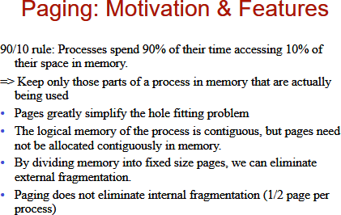
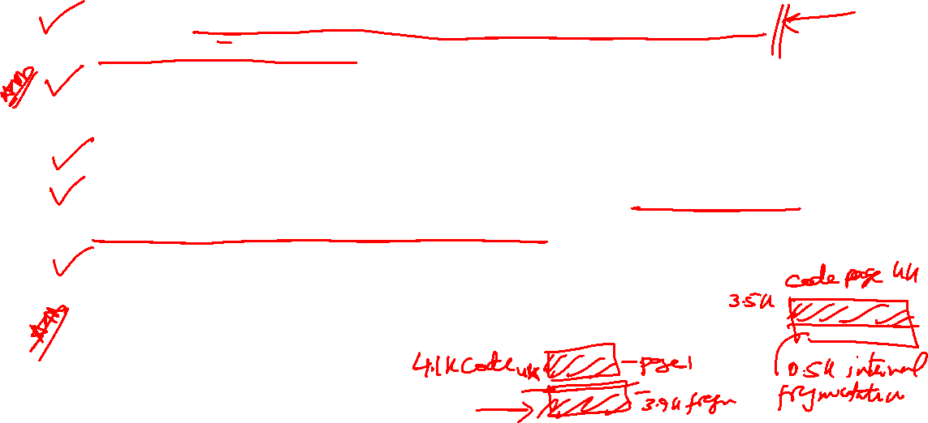

Slide 25
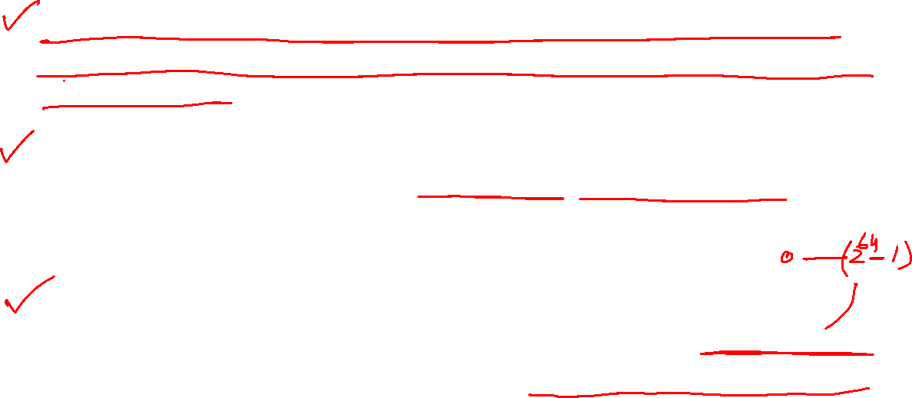
Paging breaks physical memory into fixed-sized blocks called frames and breaking logical memory into blocks of the same size called pages.
When a process is to be executed, its pages are loaded into any available memory frames from their source (a file system or the backing store). The backing store is divided into fixed-sized blocks that are the same size as the memory frames or clusters of multiple frames.
In paging, the logical address space is totally separate from the physical address space, so a process can have a logical 64-bit address space even though the system has less than 2⁶⁴ bytes of physical memory.

Slide 26
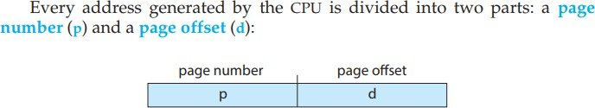
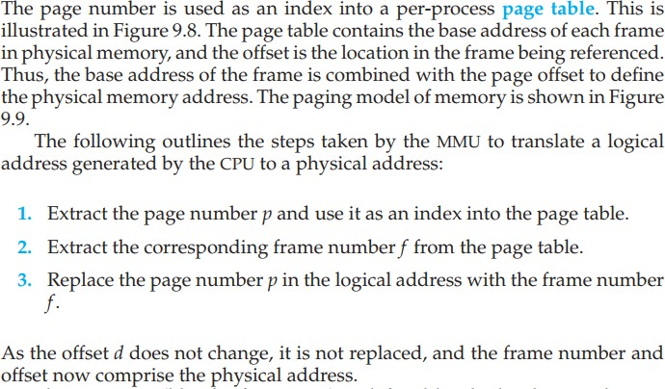
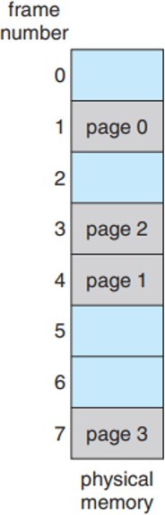
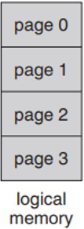
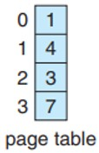
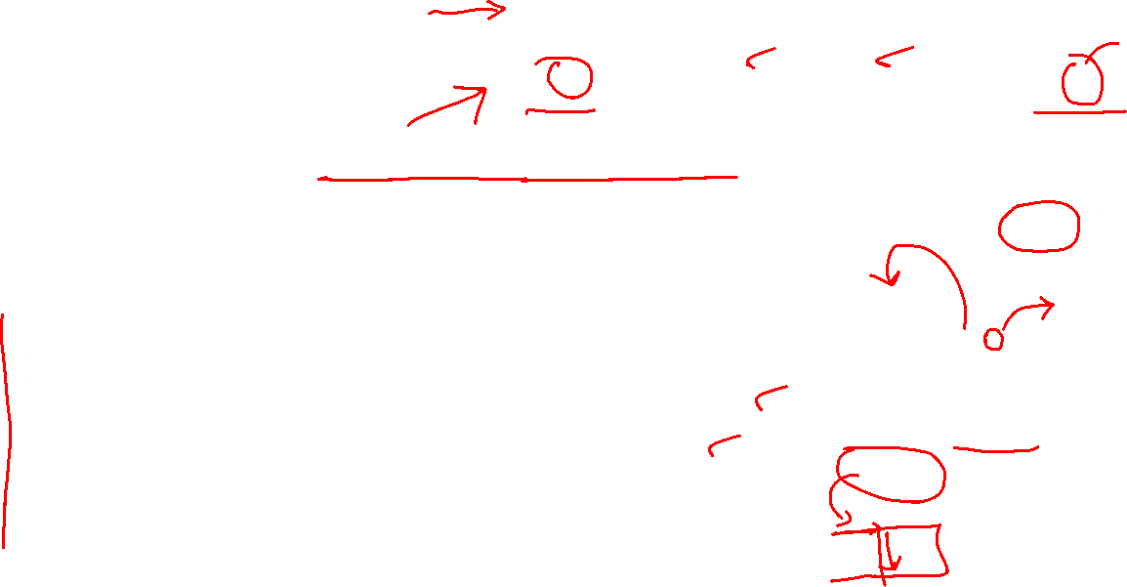

Slide 27
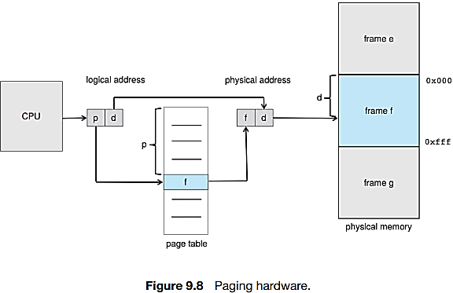



Slide 28


Page size in bits, Frame size

Slide 29




Example. Logical address, n = 2 and m = 4. Page size = 4 bytes and a physical memory of 32 bytes (8 pages). Show how the programmer’s view of memory can be mapped into physical memory.
Logical address 0 is page 0, offset 0.
Indexing into the page table, we find that page 0 is in frame 5.
Logical address 0 maps to physical address 20 [= (5 × 4) + 0].
Logical address 3 (page 0, offset 3) maps to physical address 23 [= (5 × 4) + 3].
Logical address 4 is page 1, offset 0; according to the page table, page 1 is mapped to frame 6. Thus, logical address 4 maps to physical address 24 [= (6 × 4) + 0].
Logical address 13 maps to physical address 9.
Paging is a form of dynamic relocation. Every logical address is translated by the paging hardware to some physical address. Using paging is similar to using a table of base (or relocation) registers, one for each frame of memory.

Slide 30
Paging: No External and may have some internal Fragmentation
When we use a paging scheme, we have no external fragmentation: any free frame can be allocated to a process that needs it. However, we may have some internal fragmentation. Notice that frames are allocated as units. If the memory requirements of a process do not happen to coincide with page boundaries, the last frame allocated may not be completely full.
For example, if page size is 2,048 bytes, a process of 72,766 bytes will need 35 pages plus 1,086 bytes. It will be allocated 36 frames, resulting in internal fragmentation of 2,048 - 1,086 = 962 bytes.
In the worst case, a process would need n pages plus 1 byte. It would be allocated n + 1
frames, resulting in internal fragmentation of almost an entire frame.

Slide 31


Page Details

Slide 32

Allocation of frames at process creation
When a process arrives in the system to be executed, its size, expressed in pages, is examined. Each page of the process needs one frame.
Thus, if the process requires n pages, at least n frames must be available in memory.
If n frames are available, they are allocated to this arriving process.
The first page of the process is loaded into one of the allocated frames, and the frame number is put in the page table for this process.
The next page is loaded into another frame, its frame number is put into the page table, and so on (Figure 9.11).

Slide 33
Programmer’s VS Paging view of Memory
Programmer view: memory as one single space, containing the program.
Paging view: A program is scattered throughout physical memory along with other programs.
frame table is a single, system-wide data structure. It has has one entry for each physical page frame, indicating whether the latter is free or allocated and, if it is allocated, to which page of which process (or processes).
There is also a per-process page table.
contains the base address of each frame in physical memory, and the offset is the location in the frame being referenced.
base address + page offset = physical memory address.
Page table is also used by the CPU dispatcher to define the hardware page table when a process is to be allocated the CPU. Paging therefore increases the context-switch time.
A pointer to the page table is stored with the other register values (like the instruction pointer) in the process control block of each process.
When the CPU scheduler selects a process for execution, it must reload the user registers an

Slide 34

Two memory accesses are needed to access data (one for the page-table entry and one for the actual data) with TLB. Thus, memory access is slowed by a factor of 2, a delay intolerable under most circumstances.
Translation Look-Aside Buffer (TLB) is a cache-like hardware component that stores recently accessed virtual-to-physical memory address translations in a processor. It reduces the overhead of frequent lookups in the page tables by providing faster access to translations.
When a virtual address is accessed, the TLB is checked first, and if a matching entry is found TLB Hit, the corresponding physical address is retrieved directly from the TLB.
If a match is not found TLB miss, the processor looks up the page table in memory to retrieve the translation and stores it in the TLB for future reference.
The TLB is typically implemented using high-speed associative memory and is an important component in virtual memory management.
Storing Address-Space Identifiers (ASIDs) identify each process and stored in each TLB entry. They allow for more efficient and secure handling of virtual address spaces by different processes. It enables the TLB to quickly switch between different address spaces without the need to flush all entries, reducing overhead and improving performance. Additionally, it provides a level of protection against unauthorized access to memory by ensuring that each process only accesses its own address space.

Slide 35

For instance, the Intel Core i7 CPU has a 128- entry L1 instruction TLB and a 64-entry L1 data TLB. In the case of a miss at L1, it takes the CPU six cycles to check for the entry in the L2 512-entry TLB. A miss in L2 means that the CPU must either walk through the page- table entries in memory to find the associated frame address, which can take hundreds of cycles, or interrupt to the operating system to have it do the work.

Slide 36




The valid bit in a page table can take two values, typically represented as 0 or 1. A value of 1 indicates that the page or page table entry is valid, and a value of 0 indicates that it is invalid. The operating system uses the valid bit to track which pages or page table entries are currently in use and which are not. If a process tries to access an invalid page, the CPU raises an exception, and the operating system can take appropriate action, such as allocating a new page or terminating the process.
The protection bits control the access permissions for a given page or page table entry and avoid unauthorized access or modification of memory.
The most common protection bits are the read, write, and execute bits, which determine whether a process can read, write or execute the contents of a page.
By setting appropriate protection bits, the operating system can ensure that each process can only access the memory it is authorized to use.

Slide 37




Slide 38

If each process load its own copy of libc into its address space. If a system has 40
user processes, and the libc library is 2 MB, this would require 80 MB of memory.
Reentrant code is a type of code that can be safely called by multiple tasks or processes at the same time
without interference or unintended side effects.
Reentrant code achieves this by using only local variables or variables passed as arguments and avoiding the use of global variables or shared resources. This ensures that each task or process has its own independent copy of the data and that the execution of the code does not interfere with other tasks or processes.
Reentrant code is essential in multi-tasking or multi-process environments, where multiple tasks or processes may need to access the same code simultaneously.

Slide 39

Each process has its own copy of registers and data storage to hold the data for the process’s execution. The data for two different processes will, of course, be different.
Only one copy of the standard C library need be kept in physical memory, and the page table for each user process maps onto the same physical copy of libc. Thus, to support 40 processes, we need only one copy of the library, and the total space now required is 2 MB instead of 80 MB—a significant saving!
In addition to run-time libraries such as libc, other heavily used programs can also be shared— compilers, window systems, database systems, and so on.

Slide 40






Slide 41



Instead of indexing virtual pages to physical frames as in a traditional page table, an inverted page table indexes physical frames to the processes and virtual pages that are currently mapped to them. This inversion allows for more efficient memory usage, particularly in systems with large physical memory but smaller per-process address spaces.

Slide 42



Standard swapping is a technique used in virtual memory management to temporarily transfer pages from physical memory to a swap space on a hard disk when the physical memory is full. When the page is needed again, it is swapped back into physical memory from the swap space. This allows the system to free up physical memory for other processes and enables virtual memory management.

Slide 43

Swapping with paging The swap space is divided into fixed-size blocks called "pages," which correspond to the page size used in physical memory. A page out operation moves a page from memory to the backing store; the reverse process is known as a page in. Swapping with paging is illustrated in Figure 9.20

